Slide 1
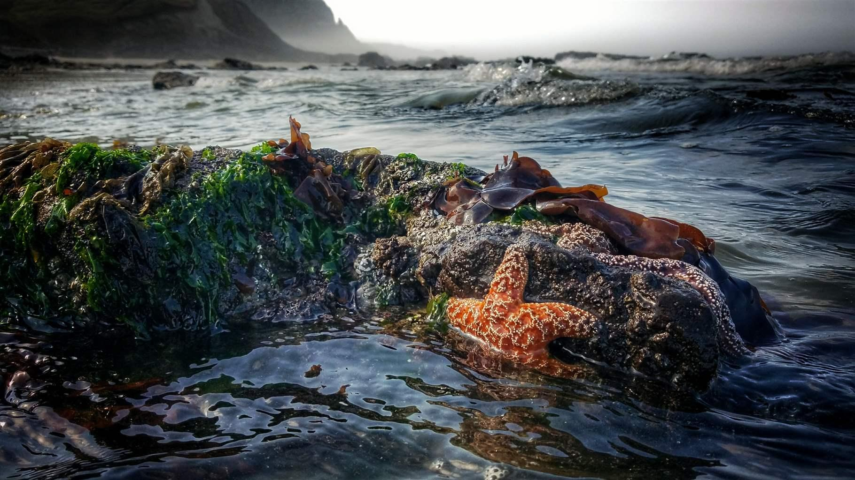
Tide Pool Biodiversity
Notes:
Good afternoon class! Today let’s take an adventure to the rocky shore and learn about tide pool biodiversity!

Slide 2
Have you ever been to a rocky shore before?
Do you know who lives in the rocky shore?
Notes:
Have any of you ever visited the tide pools?
Can you name any animals that live at the tide pools?

Slide 3
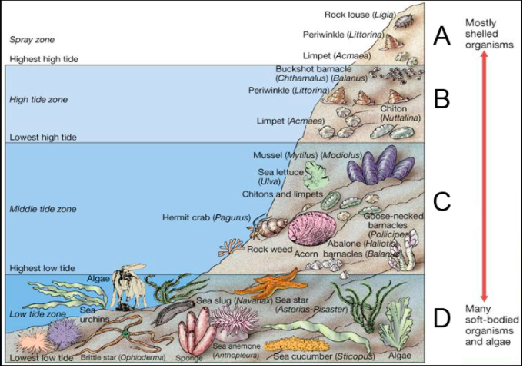
Spray Zone
High tide Zone
Lots of sea creatures live in the rocky shore!
Middle tide
Zone
Low tide
Zone
Notes:
Seals, different birds like sea gulls,

Slide 4
Can you name the creatures on the rocky shore in the picture?

Slide 5
WOW! 45 organisms!

Slide 6
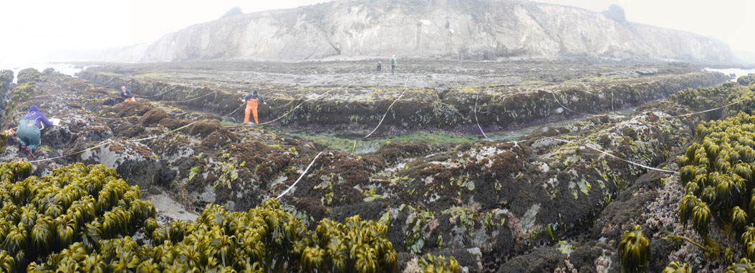
How do scientists study tide pool biodiversity?
Do you know what the scientists are doing in this picture?
Notes:
Do you know what the scientists are doing in this picture?

Slide 7
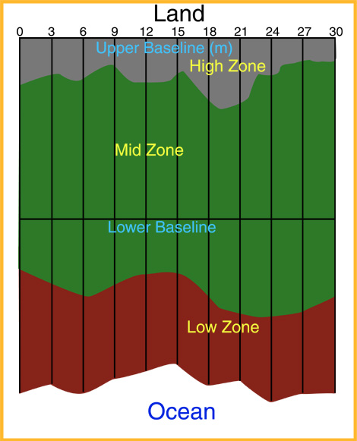
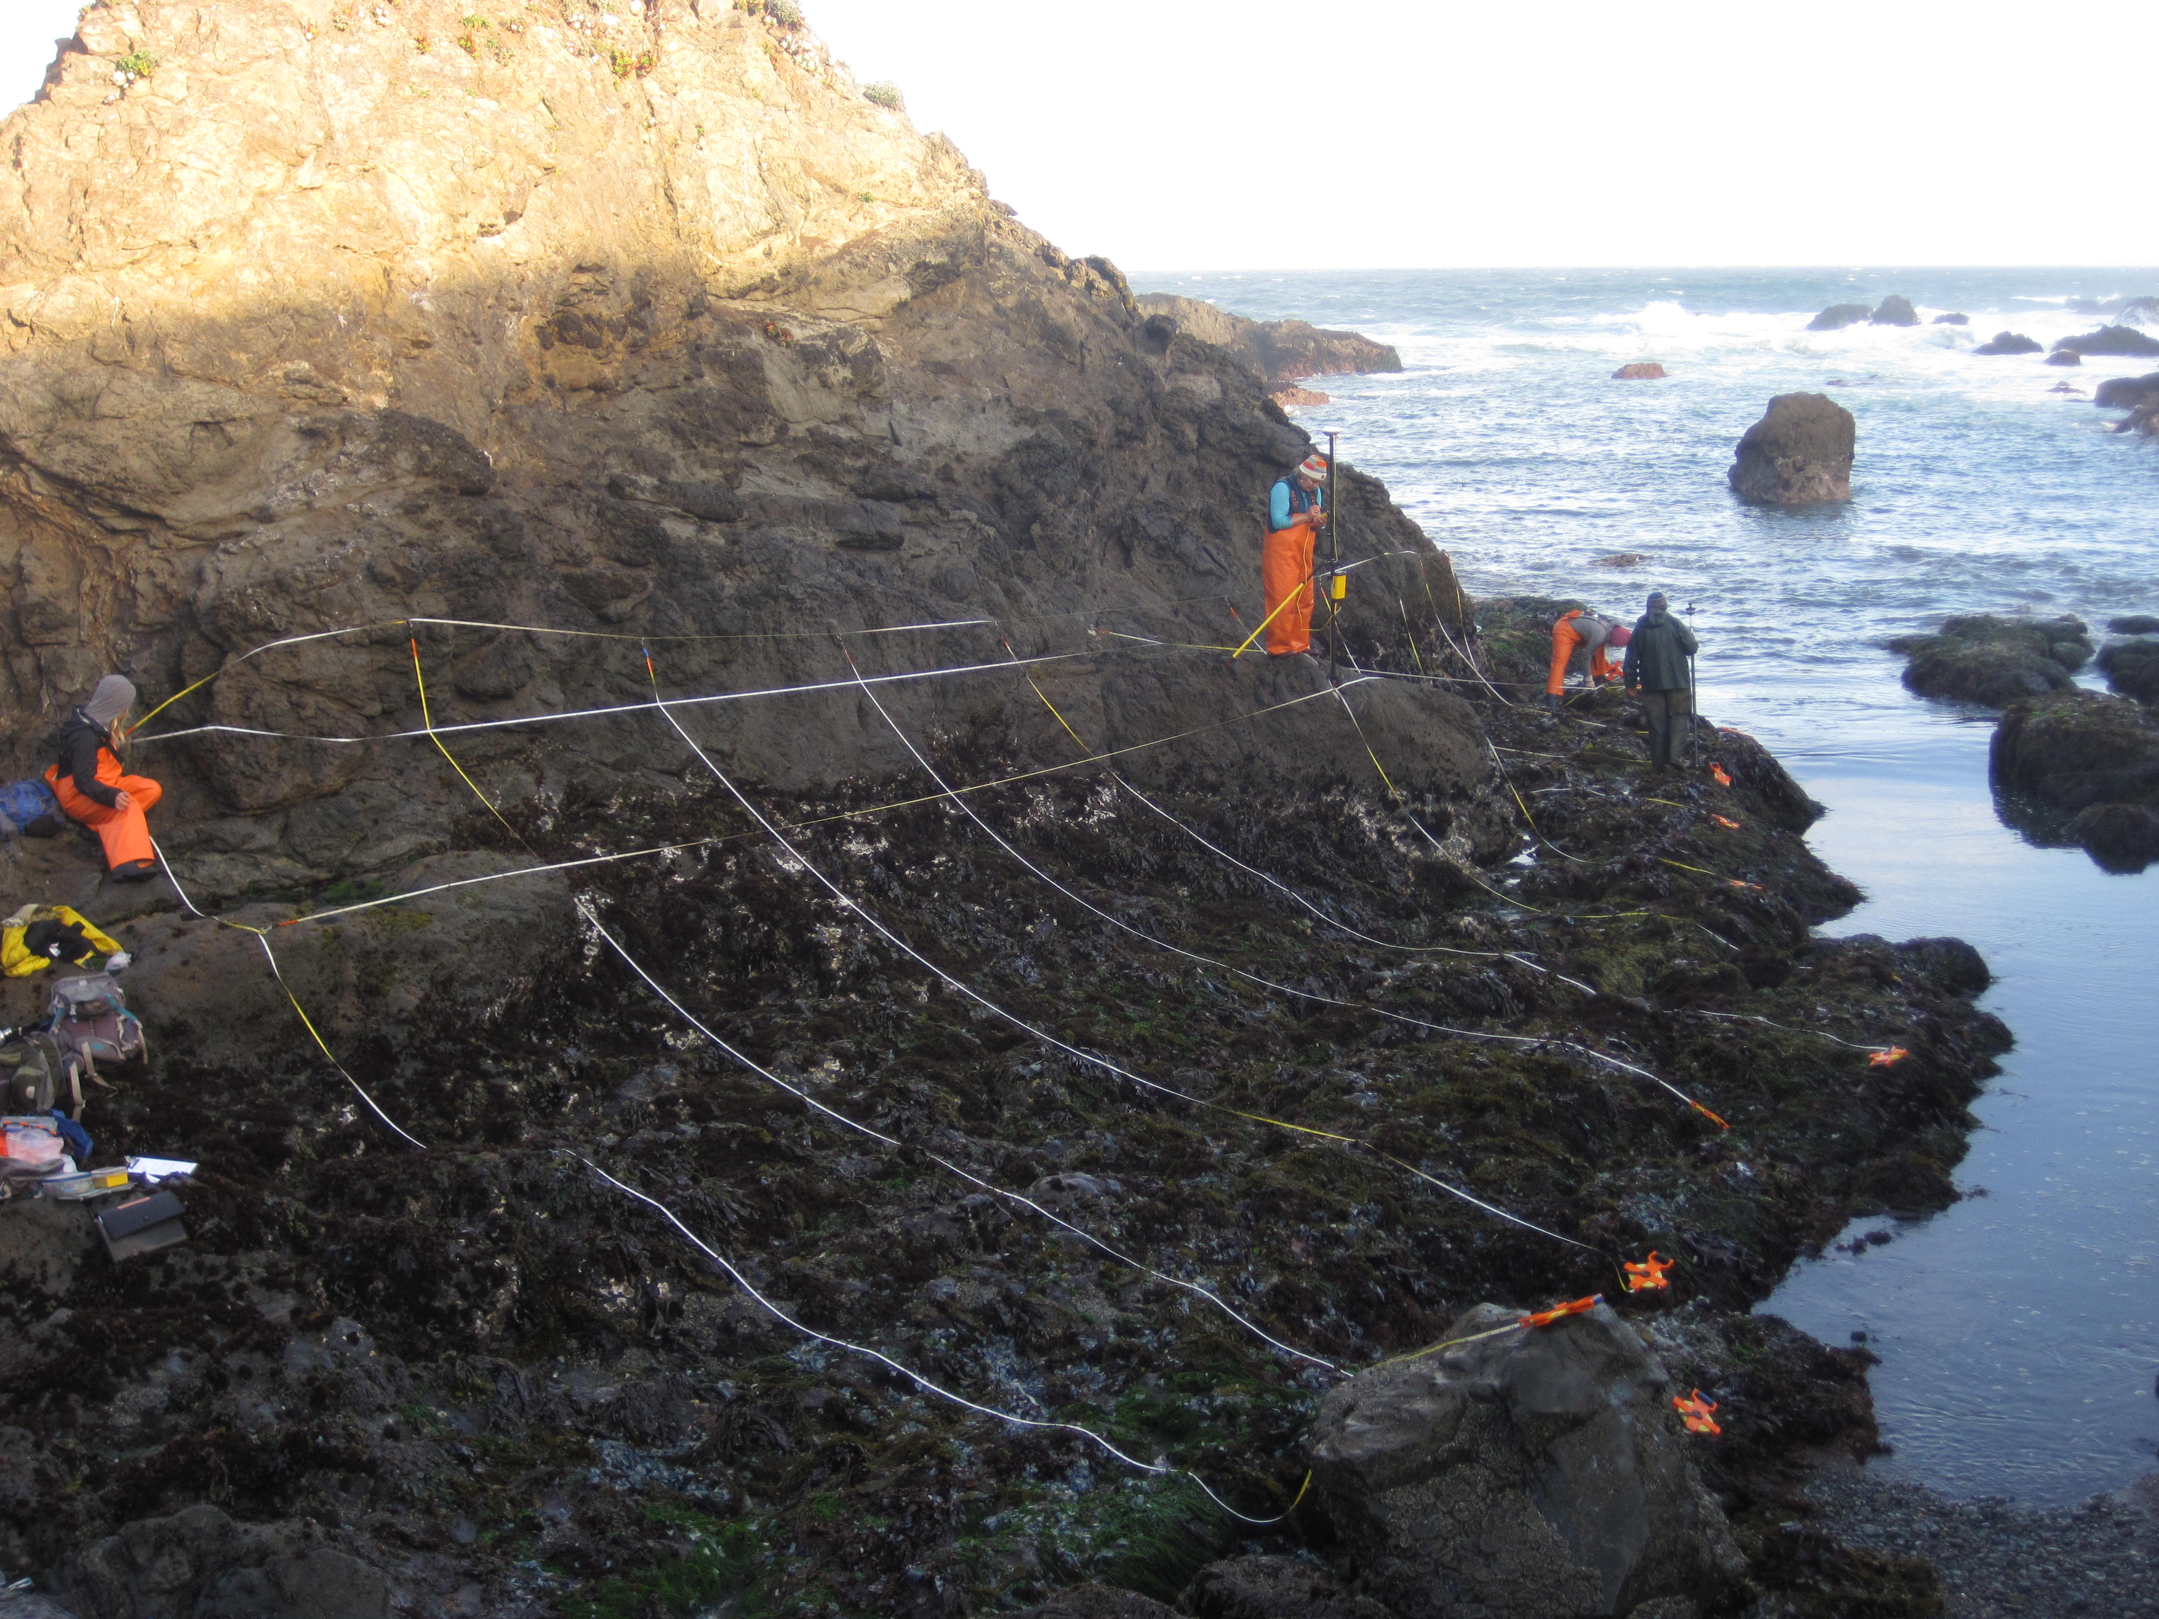
The technique is called “Transect Sampling”
Notes:
The scientists divide the rocky shores into smaller but equal rectangular grids.

Slide 8
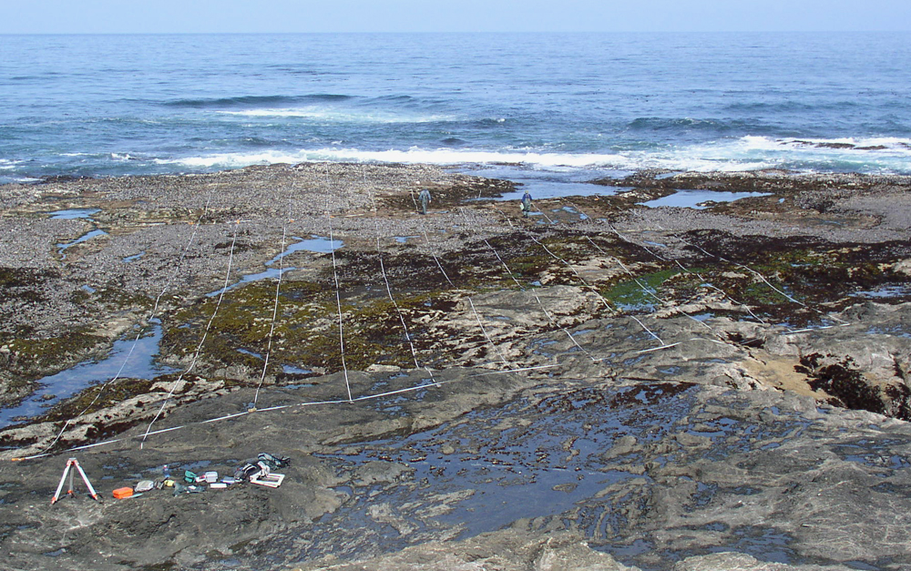
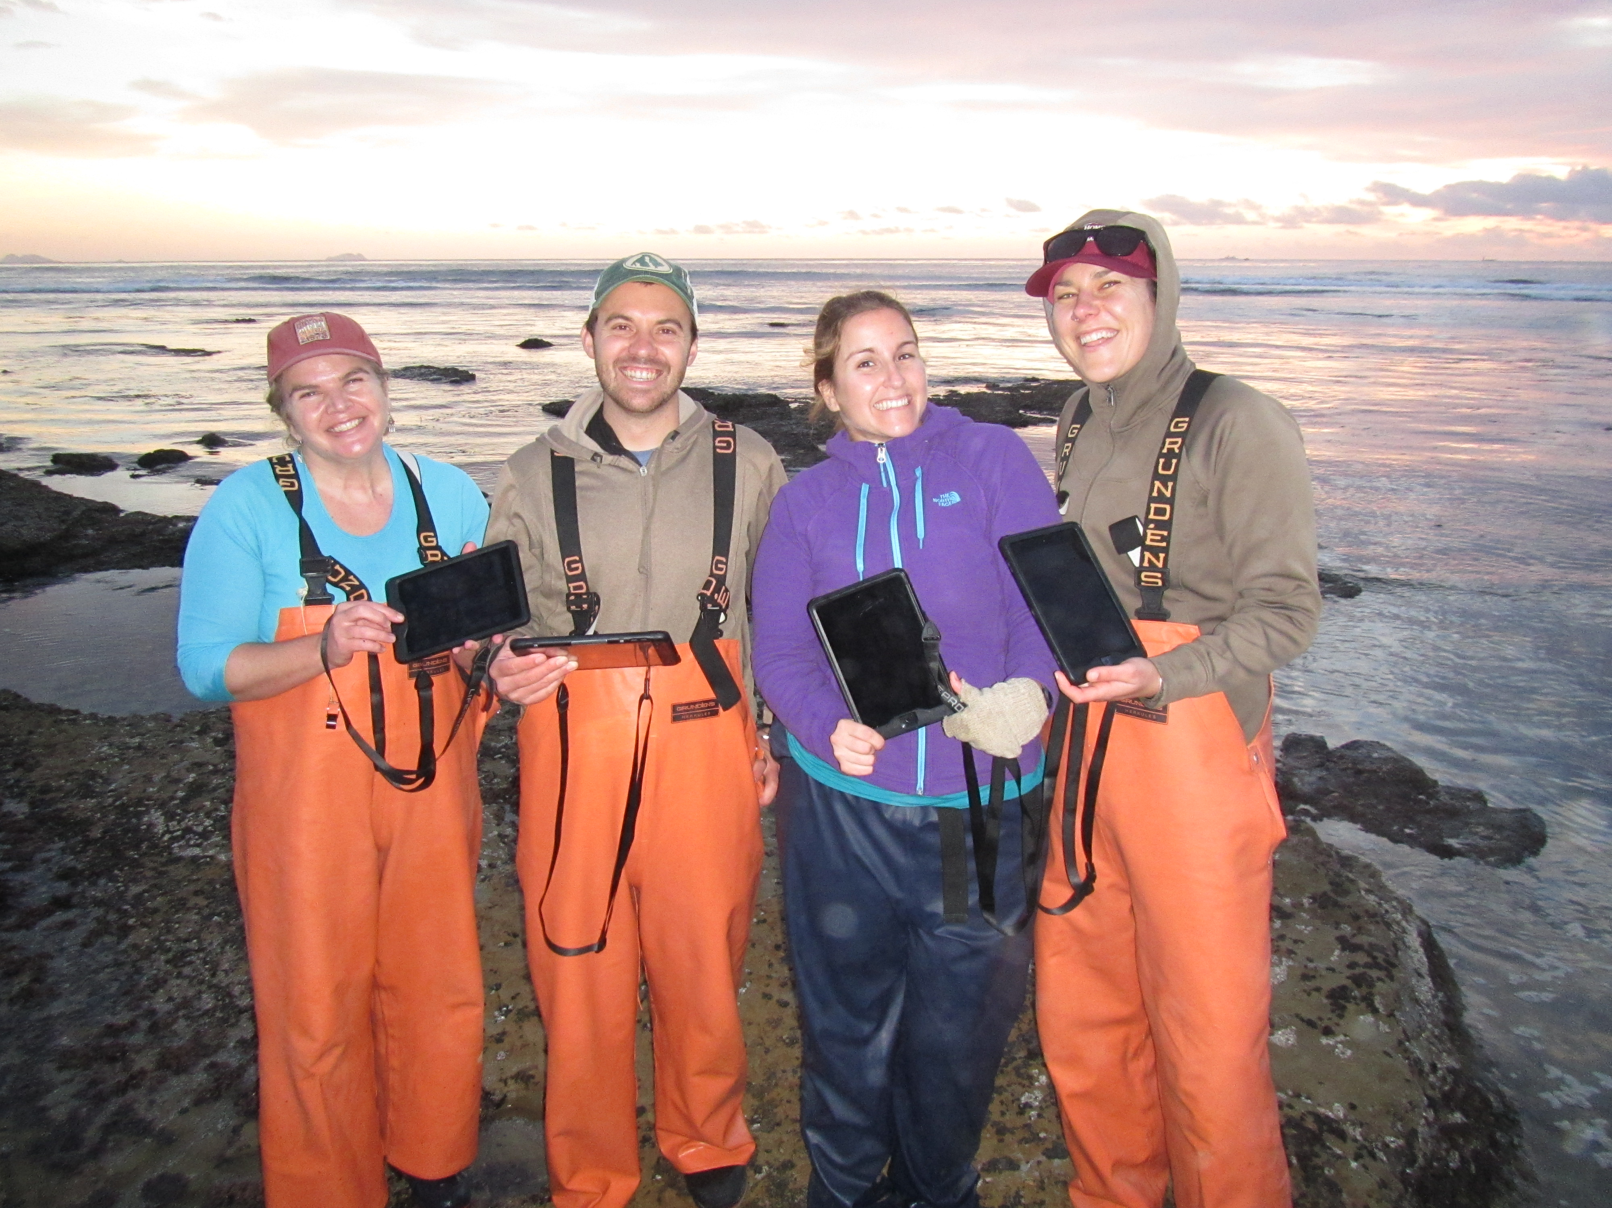
Then they identify, count the number of organisms, then record the data into their worksheet
Their data recording device
An example of Transect Sampling at the Rocky shore

Slide 9
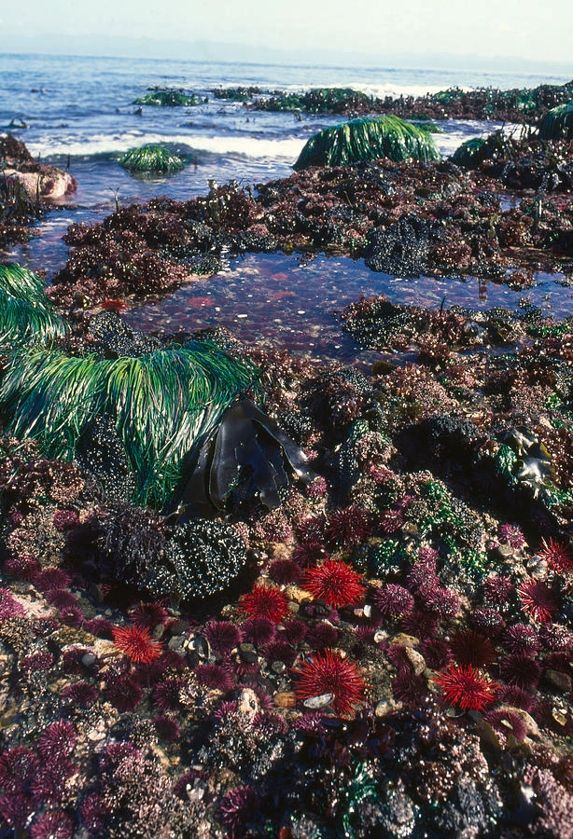
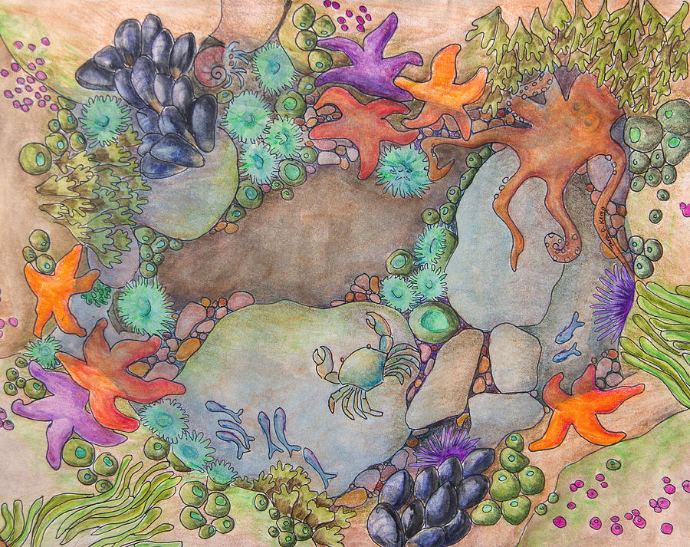
Now let’s start our fun activities!
Let’s practice what marine biologists do to study tide pool organisms!

Slide 10
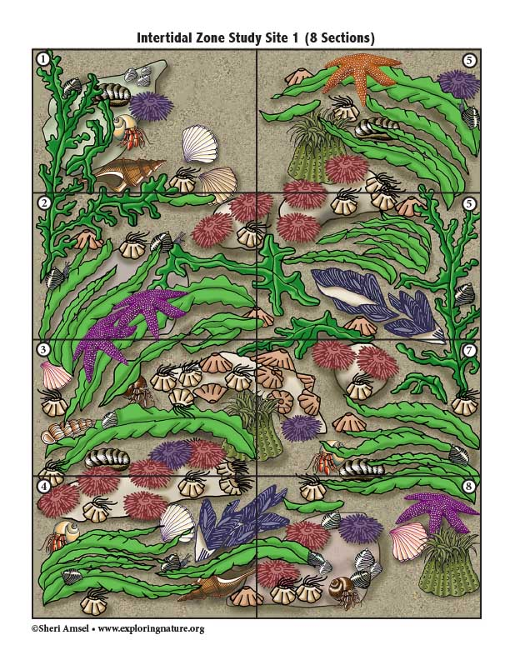
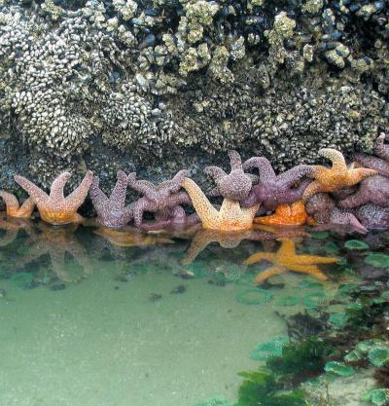

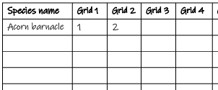
Activity 1: Evaluate tide pool biodiversity
Food for thought:
1. Have you ever been to a marine tide pool before?
2. Can you guess how many types of living creatures you can find at a tide pool?
3. Do you know how scientists study the biodiversity of the tide pool?
What you will need:
1 ruler
1 pencil
A tide pool organism key
A worksheet (next page)
2 images of 2 study sites
Step 1:
Start with Study Site A. Use the tide pool organism key to identify the organisms and count the number of each organism you see. Fill in the numbers!
Step 2:
Draw the transect sampling lines to split Study Site B into 6 small equal-size grids (3 rows x 2 columns). Number each grid from 1 to 6
1
4
2
5
3
6
Step 3:
Identify, Count and Fill in the number of organisms you see in Study Site B to the worksheet
Let’s discuss
1. Which study site has more types of organisms?
2. Which study site has more total organisms (including organisms of the same type)?
3. As a result, which study site is more diverse?
Add your final answers here (after filling the 2 worksheets)

Slide 11
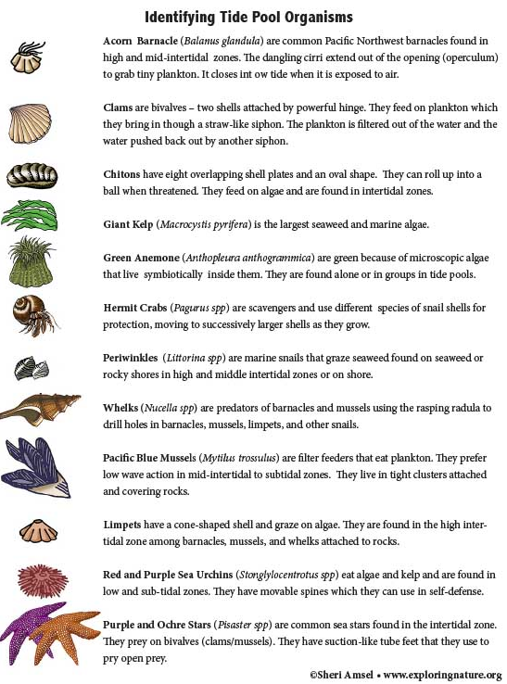
Activity 1: Evaluate tide pool biodiversity
Activity 1: Evaluate tide pool biodiversity
Study Site A

Slide 12
Activity 1: Evaluate tide pool biodiversity
Activity 1: Evaluate tide pool biodiversity
Study Site A
Worksheet for Study Site A
List the name of all the organisms that you see in Study Site A in the first column
Fill in the number of each organism that you see in each Grid
Species name | Grid 1 | Grid 2 | Grid 3 | Grid 4 | Grid 5 | Grid 6 | Grid 7 | Grid 8
Acorn barnacle | 1 | 2
N1= Total # of organisms
N2= Total # of organism types
Diversity index =N2/N1
Biodiversity (Lo, Med, Hi)
3. Per Study Site A (combination of all 8 grids):
N1 = …………… N2 = ……………. Diversity index = ……………..Biodiversity: ……………………………

Slide 13
Activity 1: Evaluate tide pool biodiversity
Activity 1: Evaluate tide pool biodiversity
Worksheet for Study Site B
Study Site B
List the name of all the organisms that you see in Study Site B in the first column
Fill in the number of each organism that you see in each Grid
Species name | Grid 1 | Grid 2 | Grid 3 | Grid 4 | Grid 5 | Grid 6
N1= Total # of organisms
N2= Total # of organism types
Diversity index =N2/N1
Biodiversity (Lo, Med, Hi)
3. Per Study Site B (combination of all 6 grids):
N1 = …………… N2 = ……………. Diversity index = …………….. Biodiversity: ……………………………

Slide 14
Activity 1: Evaluate tide pool biodiversity
Activity 1: Evaluate tide pool biodiversity
Worksheet for Study Site B
Study Site B
List the name of all the organisms that you see in Study Site B in the first column
Fill in the number of each organism that you see in each Grid
1
4
Species name | Grid 1 | Grid 2 | Grid 3 | Grid 4 | Grid 5 | Grid 6
N1= Total # of organisms
N2= Total # of organism types
Diversity index =N2/N1
Biodiversity (Lo, Med, Hi)
2
5
3
6
3. Per Study Site B (combination of all 6 grids):
N1 = …………… N2 = ……………. Diversity index = …………….. Biodiversity: ……………………………

Slide 15
Let’s discuss
1. Which study site has more types of organisms?
2. Which study site has more total organisms (including organisms of the same type)?
3. As a result, which study site is more diverse?
Study Site A
Study Site B

Slide 16
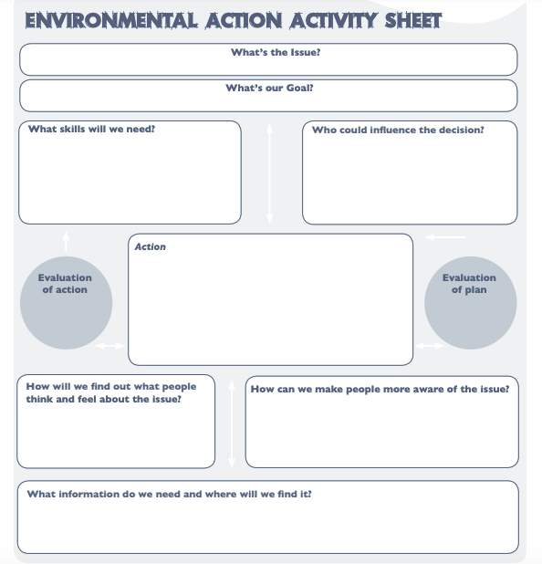
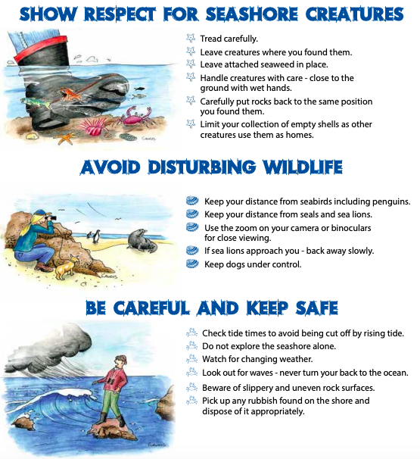
Activity 2: Human impacts on the tide pool diversity
Activity 2: Human impacts on the tide pool diversity
Food for thought:
As beach-goers, what you wish to do to protect the tidal habitat?
As a fisherman, what can you do to protect the tide pool organisms?
As city leader, what can you do to protect the beach and tide pool?
What you will need:
1 pencil
A worksheet (next page)
Group that you belong: Beach-goers Fishermen City leaders
(draw a circle)
Step 1:
Let’s divide into 3 groups to represent different groups of people to discuss our environmental action!
Group 1: Beach-goers
Group 2: Fishermen
Group 3: City leaders
Step 2:
Among your group, let’s discuss in 25 minutes the following questions for the tide pool in Southern California coast
What is the issue?
What is the goal of your group?
What skills will we need?
Who could influence the decision?
What are the actions?
How will we find out what people think and feel about the issue?
How can we make people more aware of the issue?
What information do we need and where we will find it?
Let’s share the action sheet from your group to the class

